Slide 1
CASE STUDY

Slide 2
PERFORMED BY
Surajit Gharami (AF0406773)

Slide 3
# 1
End day report

Slide 4
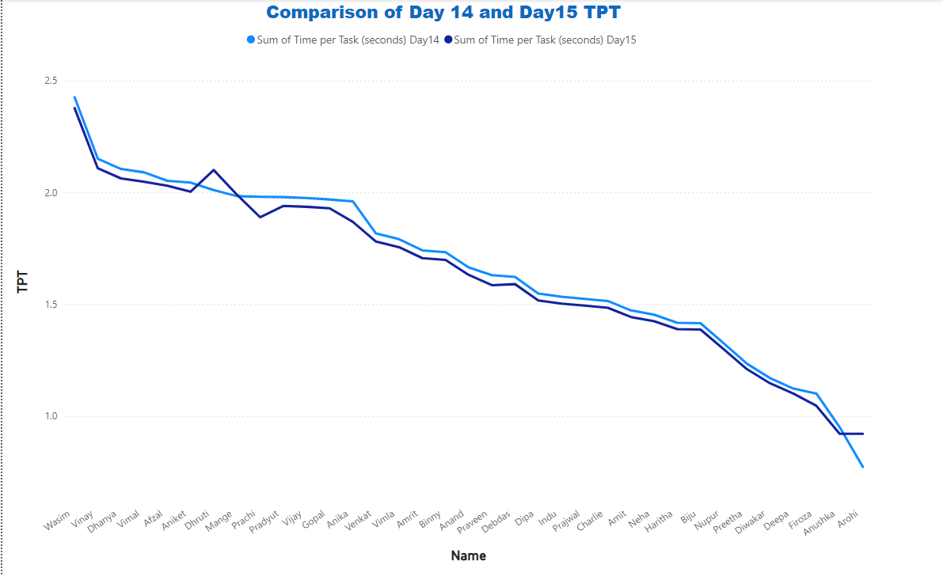



Anomalies
Did anyone take more time on Day 15 than Day 14?
Solution:
Only Dhruti, Mange, and Arohi take more time on Day 15 than Day 14.

Slide 5
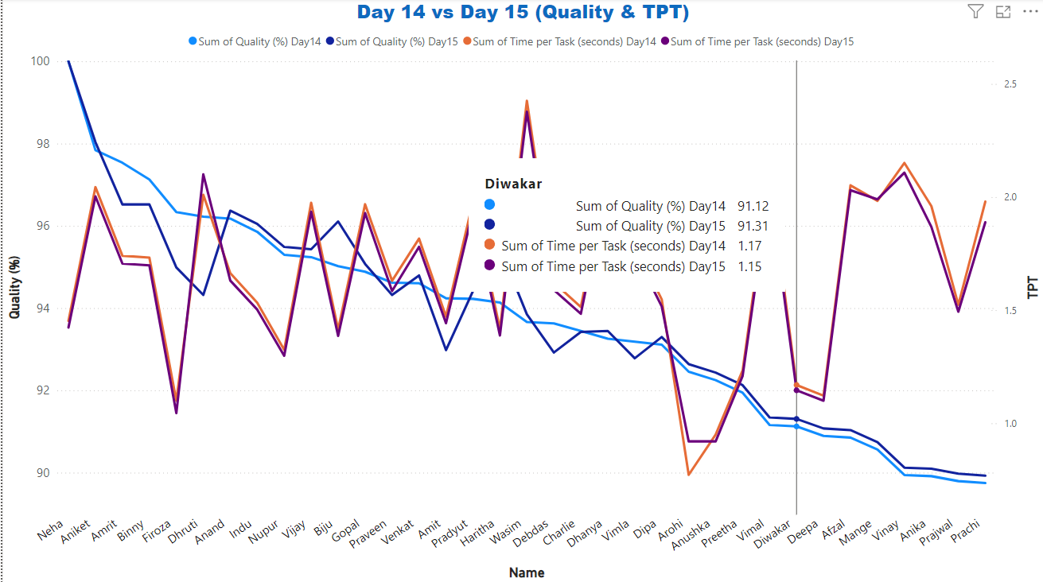
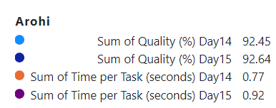
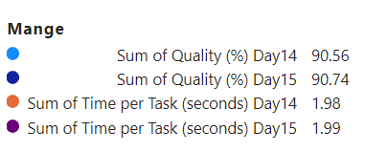
Anomalies
Did anyone take longer because they were focusing too much on the quality?
Solution:
Only Arohi and Mange.

Slide 6
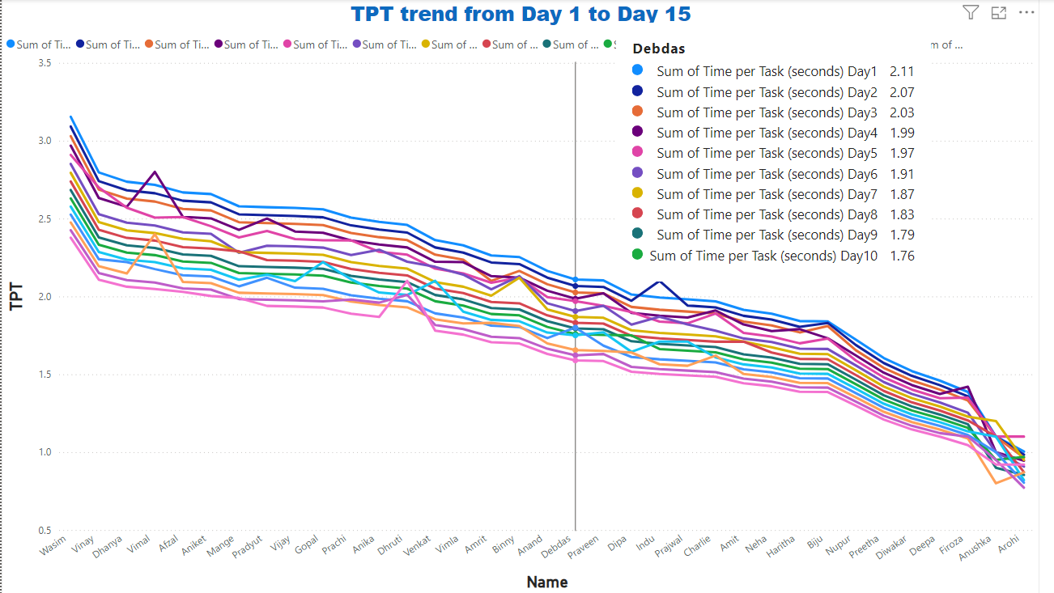
Anomalies
How many have shown improvement in terms of TPT on Day 15 ?
Solution:
Everyone shown improvement except
Mange, Arohi, Dhruti, and Anushka.

Slide 7
Anomalies
Who are the top 3 members with the lowest TPT on the 15th Day and who are the top 3 members with the lowest average TPT against day 1 to day 15? Are they the same person?
Solution:
Top 3 members with the lowest TPT on the 15th Day : Anushka, Arohi, Firoza
Top 3 members with the lowest average TPT against Day 1 to Day 15 : Anushka, Arohi, Firoza
Are they the same person : Yes, they are same.

Slide 8
# 2
Review report

Slide 9
Effectiveness
Did the average TPT improve?
Solution:
Yes, the average TPT improved over last 15 days.
Average TPT for first 15 days: 1.884686941
Average TPT for last 15 days: 1.444380147
Did the standard deviation decrease over the last 15 days?
Solution:
Yes, the standard deviation decreased over the last 15 days .
The standard deviation of TPT over the first 15 days: 0.040282122
The standard deviation of TPT over the last 15 days : 0.028496701

Slide 10
Effectiveness
Did the average TPT come down from the earlier TPT as your supervisor had indicated?
Solution:
Yes, the average TPT come down from the earlier TPT as our supervisor had indicated.

Slide 11
THANK YOU

